Slide 1

Drug Recommendation System Based On Sentiment Analysis Of Drug Reviews Using Machine Learning
by
Susmitha G
Roll No. 214G1A32A8
Sabreen Taj B
Roll No. 214G1A3289
Rishitha B
Roll No. 214G1A3286
Siddu Veera Venkatesh B
Roll No. 214G1A32A0
Under the guidance of
Ms. K. Nalini Priyanka,_{M. Tech.}
Assistant Professor
Department of Computer Science and Engineering (Data Science)
Srinivasa Ramanujan Institute of Technology
(Affiliated to JNTUA & Approved by AICTE) (Accredited by NAAC with ‘A’ Grade & Accredited by NBA (EEE, ECE & CSE)
Rotarypuram Village, B K Samudram Mandal, Ananthapuramu – 515701.
2024 - 2025

Slide 2
Abstract
The COVID-19 pandemic highlighted critical healthcare challenges, including shortages of professionals, equipment, and medicines, leading to self-medication and worsening health outcomes. This study proposes a Drug Recommendation System using machine learning and sentiment analysis to recommend effective medicines for specific diseases based on patient reviews. The system processes datasets, applies machine learning models with vectorization methods like BoW, TF-IDF, and Word2Vec, and evaluates performance using precision, recall, F1-score, and accuracy. By identifying patterns in patient feedback, it ensures recommendations are data-driven and reliable. Analyzed sentiments identify top-rated drugs, enabling informed medication choices and reducing the burden on healthcare providers. This solution is particularly valuable during pandemics, enhancing patient outcomes and supporting constrained healthcare systems, while fostering trust in AI-driven healthcare tools.

Slide 3

Contents
Abstract
Problem Statement
Objectives
Literature survey
Proposed Work
Introduction
Existing System
Proposed System
Planning
Requirements
UML Diagram
Data Flow Diagram
Data Processing Techniques
References
GitHub Link
Queries

Slide 4
Problem Statement
The COVID-19 pandemic highlighted the inaccessibility of adequate clinical resources, including a shortage of specialists, healthcare workers, proper equipment, and medicines. Patients often self-medicated without professional consultation, worsening their health conditions. This project aims to address these issues by developing a Drug Recommendation System based on sentiment analysis of patient reviews, leveraging machine learning techniques to recommend the most effective drug for specific conditions.

Slide 5
Objectives of project
1.To develop a system that analyzes patient reviews and predicts sentiments using advanced vectorization techniques and machine learning algorithms.
To recommend the most effective drug for a specific condition by evaluating sentiment predictions and useful counts.
To improve the accuracy and speed of drug recommendations by combining predictions from multiple high-performing models.

Slide 6
Literature Survey
 | Title | Author | Journal Name & Year | Methodology Adapted | Key Findings | Gaps
1. | A Medication Recommendation Framework Based on Sentiment Analysis of Drug Reviews Using AI | Satvik Garg | 2021 11th International Conference on Cloud Computing, Data Science & Engineering (Confluence) | Strategic Regression, Perceptron, Multinomial Naive Bayes, Edge Classifier, Stochastic Gradient Descent, LinearSVC | AI techniques applied to drug review sentiment analysis showed potential for drug recommendation based on sentiments | No mention of specific performance metrics; lack of clear real-world validation for the recommendation system
2. | A Comparative Study of Machine Learning Algorithms and LSTM for Text Classification in Healthcare Data | Siji Rani S, Shilpa P, Aswin G Menon | Journal of Procedia Computer Science, 2024 | Explored supervise ML algorithms & LSTM models for text classification. Preprocessing steps: tokenization, special character removal. Metrics: Accuracy,precision recall, F1-score. | LSTM effectively handles long-term dependencies in sequential text data like healthcare feedback. ML algorithms provide good accuracy but struggle with imbalanced datasets. | High computational cost for LSTM models. - Challenges in interpretability for deep neural networks. - Hyperparameter tuning difficulties.

Slide 7
Proposed Work
Input Data Collection : Collect patient reviews from public datasets related to drug efficiency and user experiences.
Text Vectorization Techniques : Apply methods like BoW, TF-IDF, Word2Vec, and Manual Feature Analysis to transform text data into numerical representations.
Sentiment Classification : Use multiple classification algorithms (e.g., Linear SVC, Random Forest) to predict sentiments (positive, negative, neutral).
Combined Prediction : Select the top four performing models based on evaluation metrics like accuracy, F1 score, and AUC. Combine their predictions for enhanced accuracy.

Slide 8
Contd…
Drug Scoring and Recommendation : Multiply the combined prediction score with normalized useful counts to rank drugs for a specific condition.
Data Collection
Data Preprocessing
Train Data
Model Training
Test data
Sentiment Classification
Top Models Selection
Result Merging
Score Calculation
Drug Recommendation

Slide 9
Introduction
The availability of accurate and reliable medical recommendations is critical in healthcare, especially during emergencies such as the COVID-19 pandemic. With the growing volume of patient feedback and reviews available online, there is an opportunity to leverage this data to improve drug recommendations. By analyzing patient reviews using sentiment analysis and machine learning techniques, it is possible to create a system that aids users in identifying the most suitable drugs for their specific conditions. This project focuses on building a Drug Recommendation System that utilizes advanced algorithms to process patient reviews, predict sentiments, and recommend effective drugs.

Slide 10
Existing System
The Existing system focuses on the fact that the recommended drug should depend upon the patient’s capacity. For example, if the patient’s immunity is low, at that point, reliable medicines ought to be recommended. Proposed a risk level classification method to identify the patient’s immunity. For example, in excess of 60 risk factors, hypertension, liquor addiction, and so forth have been adopted, which decide the patient’s capacity to shield himself from infection. A web-based prototype system was also created, which uses a decision support system that helps doctors select first-line drugs.

Slide 11
Proposed System
Proposed System utilizes Sentiment Analysis of Patient Reviews to Predict Drug effectiveness and it employs Multiple Machine Learning Models for Improved Accuracy.
Combines Predictions from Top Models to Generate a Comprehensive Drug Score.
Multiplies Combined Scores With Normalized Useful Counts for Ranking Drugs.
Recommends Drug With Higher Rank Value.
Advantages:
Very high accuracy.
Faster predictions.

Slide 12
Planning
Define the project goal of developing a drug recommendation system using machine learning to improve accuracy and ease for users.
Identify requirements and gather functional and non- functional requirements.
Include a user-friendly interface, a backend powered by machine learning classifiers, and a database for storing reviews and drug information.
Development phases: Data collection and preprocessing, building classifiers, combining top predictions, and calculating drug scores.
Ensure high accuracy by using efficient machine learning algorithms and use sentiment analysis to identify positive or negative feedback in reviews.

Slide 13
Requirements
Functional Requirements: Functional requirements describe the core functions and capabilities that the system must provide to meet its objectives. These are specific actions or tasks that the system should perform.
Ability to input and preprocess drug reviews.
Perform sentiment analysis using machine learning models.
Recommend the top-ranked drug for a given condition.
Non-Functional Requirements: Non-Functional Requirements or Non-behavioural requirements, are the qualities that a system should have, but they do not specify what the system should do.

Slide 14
Contd...
Non-Functional Requirements:
Software Requirements:
• Operating System: Windows 7/10/11
• Programming Language: Python
IDE/Workbench: VS Code
Hardware Requirements:
• Processor – i3
• Speed – 2.4 GHz
• RAM – 4 GB
• Hard Disk - 500 GB

Slide 15
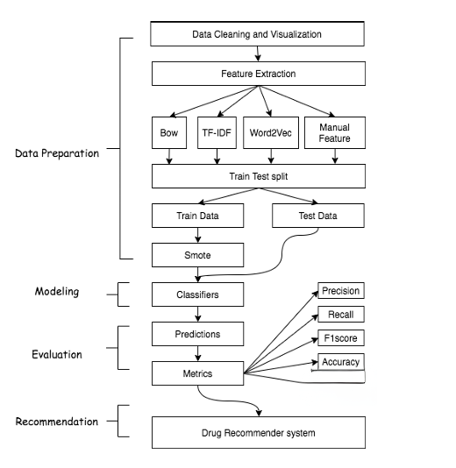




Data Flow Diagram
Fig: working of proposed work
Data Collection
Data Processing
Test data

Slide 16
Data Processing Techniques
Data Validation: Ensure that the collected patient reviews are complete, accurate, and free from errors. This involves checking for missing or duplicated data.
Data Cleaning: Remove unwanted text elements such as special characters, numbers, and stopwords, (e.g., "and," "the") from the reviews to focus only on meaningful content.
Tokenization: Break down sentences into smaller units (words or tokens), making it easier for machine learning models to process the data.
Text Vectorization: Convert the text into numerical formats using techniques like (BoW), TF-IDF,Word2vec which translates text into a machine-readable format for model training.
Normalization: Scale and standardize numerical data, such as useful counts, to a consistent range so that all features have equal importance during analysis.

Slide 17
References
[1]. Satvik Garg, “Drug Recommendation System based on Sentiment Analysis of Drug Reviews using Machine Learning”, 2021 11th International Conference on Cloud Computing, Data Science & Engineering (Confluence).
[2]. P. Sivakumar, N. Nanthini, S. Suruthi, T. Veronica, “Drug Prescribing System Using Patient Reviews Based on Sentimental Analysis”, Journal of Coastal Life Medicine, Haikou, China.
[3]. Shubham Throat, Tushar Bargal, Rahul Chavan, Shraddha Ghodekar, Nilesh Gunaware, “Drug Recommendation System based on Sentiment Analysis of Drug Reviews using Machine Learning”, International Journal for Research in Applied Science & Engineering Technology (IJRASET).

Slide 18
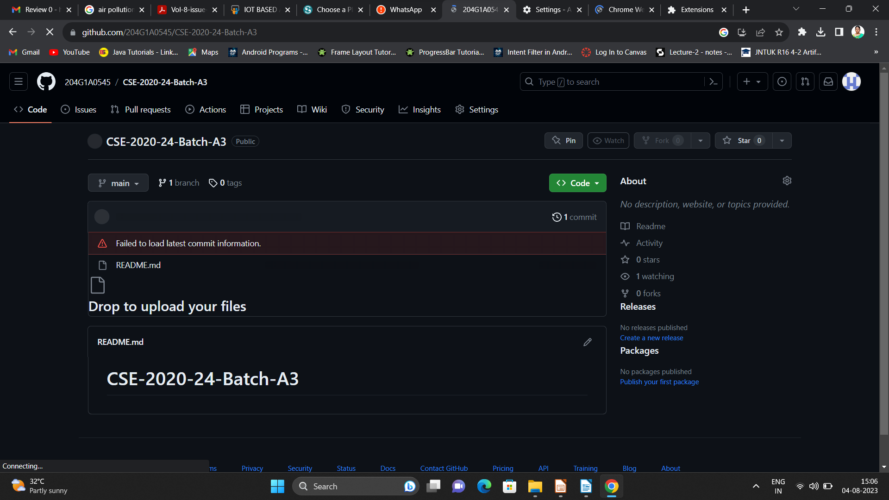

GitHub Link

Slide 19
Any Queries?

Slide 20
Thank You!!!

